Slide 1

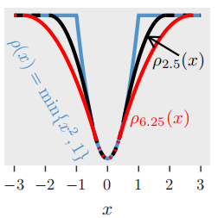
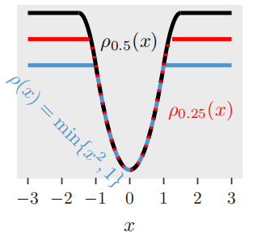
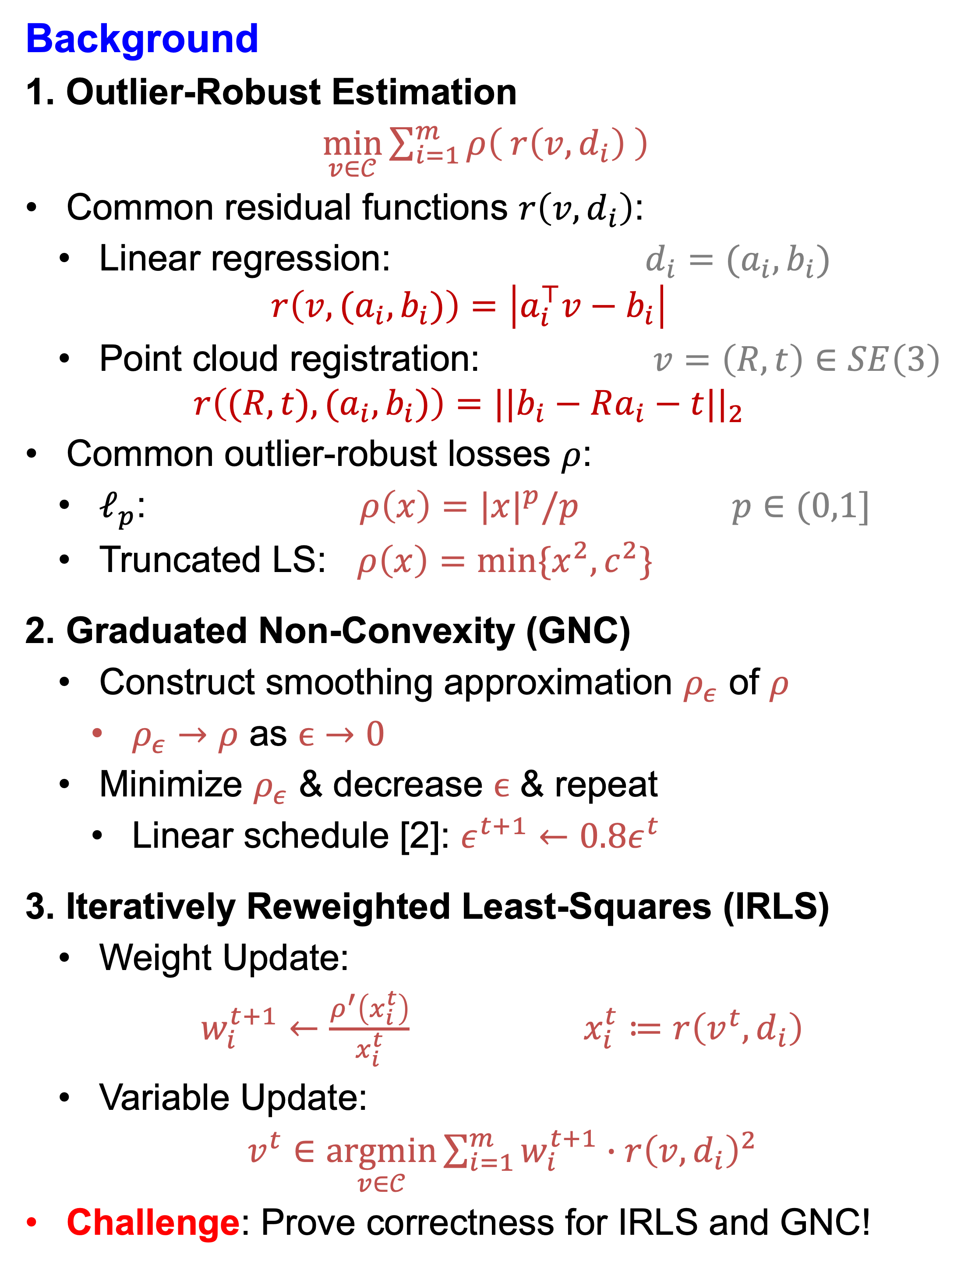


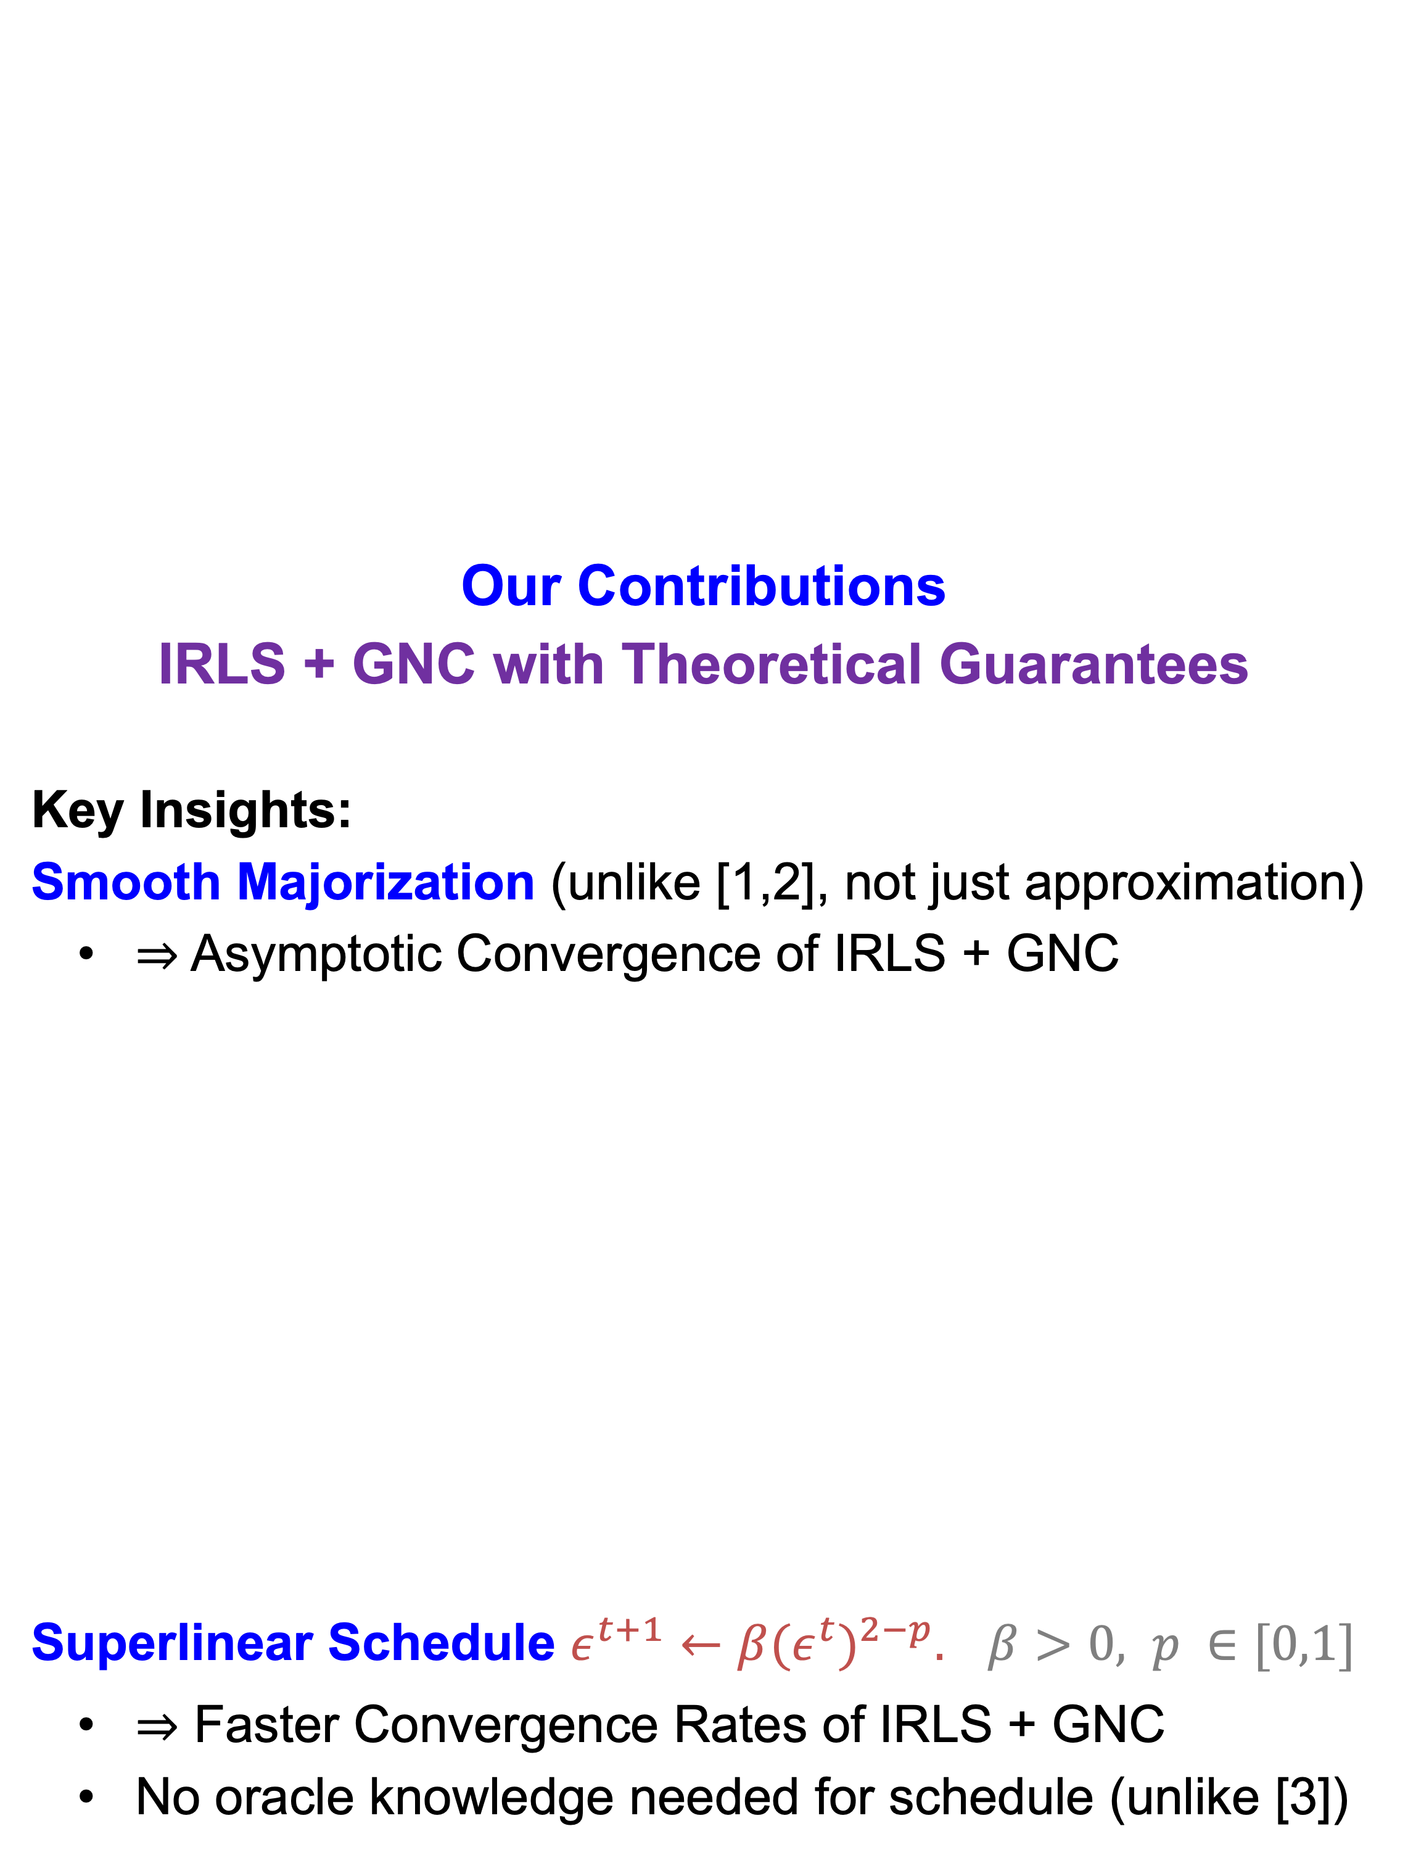
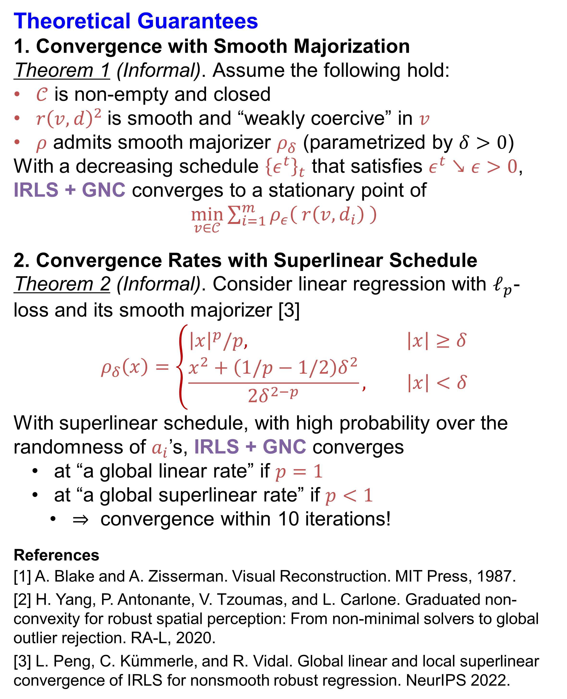
On the Convergence of IRLS and Its Variants in Outlier-Robust Estimation Liangzu Peng¹ Christian Kümmerle² René Vidal¹
¹Johns Hopkins University ²University of North Carolina at Charlotte
Background
1. Outlier-Robust Estimation
$\min_{v∈𝒞}{\sum_{i=1}^{m}{ρ\left( r\left(v,d_{i}\right) \right)}}$
Common residual functions $r\left(v,d_{i}\right)$:
Linear regression: $d_{i}=(a_{i},b_{i})$
$$r\left(v, (a_{i},b_{i})\right)=\left|a_{i}^{⊤}v−b_{i}\right|$$
Point cloud registration: $v=\left(R,t\right)∈SE\left(3\right)$
$$r\left((R,t), (a_{i},b_{i})\right)={||b_{i}−Ra_{i}−t||}_{2}$$
Common outlier-robust losses $ρ$:
$ℓ_{p}$: $ρ\left(x\right)={|x|}^{p}/p$ $p∈(0,1]$
Truncated LS: $ρ\left(x\right)=min⁡\{x^{2},c^{2}\}$
2. Graduated Non-Convexity (GNC)
Construct smoothing approximation $ρ_{ε}$ of $ρ$
$ρ_{ε}→ρ$ as $ϵ→0$
Minimize $ρ_{ε}$ & decrease $ϵ$ & repeat
Linear schedule [2]: $ε^{t+1}←0.8ε^{t}$
3. Iteratively Reweighted Least-Squares (IRLS)
Weight Update:
$w_{i}^{t+1}←\frac{ρ^{′}\left(x_{i}^{t}\right)}{x_{i}^{t}} x_{i}^{t}≔r\left(v^{t},d_{i}\right)$
Variable Update:
$v^{t}∈\underset{v∈𝒞}{argmin}{\sum_{i=1}^{m}{{w_{i}^{t+1}∙r\left(v,d_{i}\right)}^{2}}}$
Challenge: Prove correctness for IRLS and GNC!
Our Contributions
IRLS + GNC with Theoretical Guarantees
Key Insights:
Smooth Majorization (unlike [1,2], not just approximation)
$⇒$Asymptotic Convergence of IRLS + GNC
Superlinear Schedule $ε^{t+1}←β{(ε^{t})}^{2−p}. β>0, p ∈[0,1]$
$⇒$ Faster Convergence Rates of IRLS + GNC
No oracle knowledge needed for schedule (unlike [3])
Theoretical Guarantees
1. Convergence with Smooth Majorization
Theorem 1 (Informal). Assume the following hold:
$𝒞$ is non-empty and closed
${r\left(v,d\right)}^{2}$is smooth and “weakly coercive” in $v$
$ρ$ admits smooth majorizer $ρ_{δ}$ (parametrized by $δ>0$)
With a decreasing schedule ${\left\{ε^{t}\right\}}_{t}$ that satisfies $ε^{t}↘ε>0$, IRLS + GNC converges to a stationary point of
$\min_{v∈𝒞}{\sum_{i=1}^{m}{ρ_{ε}\left( r\left(v,d_{i}\right) \right)}}$
2. Convergence Rates with Superlinear Schedule
Theorem 2 (Informal). Consider linear regression with $ℓ_{p}$-loss and its smooth majorizer [3]
$$ρ_{δ}\left(x\right)=\left\{\begin{aligned}{\left|x\right|}^{p}/p, \left|x\right|≥δ \\ &\frac{x^{2}+\left(1/p−1/2\right)δ^{2}}{2δ^{2−p}}, \left|x\right|<δ\end{aligned}\right.$$
With superlinear schedule, with high probability over the randomness of $a_{i}$’s, IRLS + GNC converges
at “a global linear rate” if $p=1$
at “a global superlinear rate” if $p<1$
$⇒$ convergence within 10 iterations!
References
[1] A. Blake and A. Zisserman. Visual Reconstruction. MIT Press, 1987.
[2] H. Yang, P. Antonante, V. Tzoumas, and L. Carlone. Graduated non-convexity for robust spatial perception: From non-minimal solvers to global outlier rejection. RA-L, 2020.
[3] L. Peng, C. Kümmerle, and R. Vidal. Global linear and local superlinear convergence of IRLS for nonsmooth robust regression. NeurIPS 2022.
TLS Approximation [1,2]
$ρ_{ε}\left(x\right)=\left\{\begin{aligned}\begin{aligned}c^{2}, x^{2}≥(ε+1)c^{2} \\ x^{2}&, x^{2}≤\frac{c^{2}}{ε+1}\end{aligned} \\ &\frac{2c\left|x\right|\sqrt{\left(ε+1\right)}−ε(x^{2}+c^{2})}{ε^{2}}, o/w\end{aligned}\right.$
TLS Smooth Majorizer
$ρ_{ε}\left(x\right)=\left\{\begin{aligned}\begin{aligned}(ε+1)c^{2}, x^{2}≥(ε+1)c^{2} \\ x^{2}&, x^{2}≤c^{2}\end{aligned} \\ &\frac{2c\left|x\right|\left(ε+1\right)−x^{2}−(ε+1)c^{2}}{ε}, o/w\end{aligned}\right.$
Notes:
1

